Slide 1
Countries overview
June 2015

Slide 2
Methodology
Participating countries in 2014
New countries in 2015
13 600 European employees
questioned in January 2015,
in 14 countries :
Germany, Belgium, Spain, France, Italy, Sweden, the United Kingdom,
and this year, Poland, Romania, Turkey, Finland, Austria, Czech Republic, the Netherlands
Online survey undertaken in January 2015 by Ipsos

Slide 3
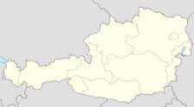
WELL-BEING
AUSTRIA
Happy at work
(% often)
Quality of life at work (% scores 8-10)
55%
#2*
#2
51%
CONFIDENCE
Country future
(% confidents)
Professional future
(% confident)
60%
#2
#2
65%
Data (eurostat)
Growth rate of GDP: 1,6%
Active population: 4,4 M
Unemployment rate: 4,8%
*# rank among the 14 European countries
MOTIVATION
Motivation
(% is increasing + remaining stable)
Concerns (%)
71%
#6
job
wage
time
DEVELOPMENT
Stay in your company
(% yes)
Find a comparable job
(% easy)
58%
#7
#5
40%

Slide 4
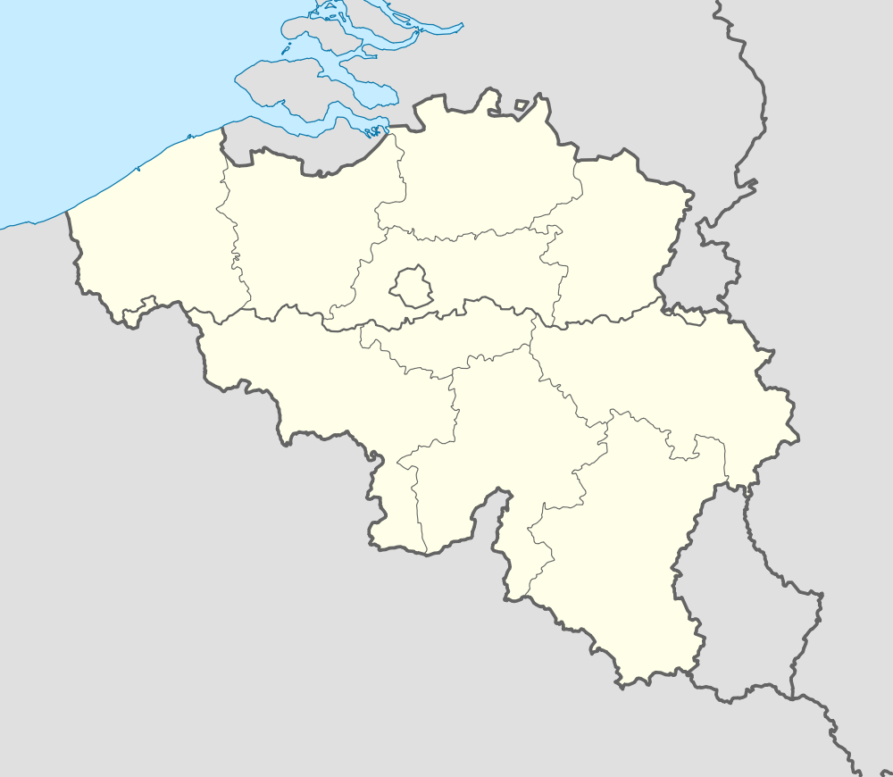
WELL-BEING
BELGIUM
Happy at work
(% often)
Quality of life at work (% scores 8-10)
49%
#3*
#7
40%
CONFIDENCE
Country future
(% confidents)
Professional future
(% confident)
37%
#7
#6
60%
Data (eurostat 2014)
Growth rate of GDP: 1,4%
Active population: 4,9 M
Unemployment rate: 8,5%
*# rank among the 14 European countries
MOTIVATION
Motivation
(% is increasing + remaining stable)
Concerns (%)
70%
#7
job
wage
time
DEVELOPMENT
Stay in your company
(% yes)
Find a comparable job
(% easy)
70%
#2
#3
43%

Slide 5
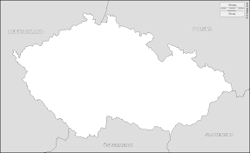
WELL-BEING
CZECH REP
Happy at work
(% often)
Quality of life at work (% scores 8-10)
27%
#11*
#7
40%
CONFIDENCE
Country future
(% confidents)
Professional future
(% confident)
37%
#7
#8
56%
Data (eurostat 2014)
Growth rate of GDP: 2%
Active population: 5,3 M
Unemployment rate: 6,7%
*# rank among the 14 European countries
MOTIVATION
Motivation
(% is increasing + remaining stable)
Concerns (%)
72%
#5
job
wage
time
DEVELOPMENT
Stay in your company
(% yes)
Find a comparable job
(% easy)
61%
#5
#8
35%

Slide 6
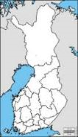
WELL-BEING
FINLAND
Happy at work
(% often)
Quality of life at work (% scores 8-10)
35%
#7*
#1
53%
CONFIDENCE
Country future
(% confidents)
Professional future
(% confident)
39%
#6
#4
63%
Data (eurostat 2014)
Growth rate of GDP: 0,2%
Active population: 2,7 M
Unemployment rate: 8,5%
*# rank among the 14 European countries
MOTIVATION
Motivation
(% is increasing + remaining stable)
Concerns (%)
73%
#4
job
wage
time
DEVELOPMENT
Stay in your company
(% yes)
Find a comparable job
(% easy)
56%
#9
#8
35%

Slide 7
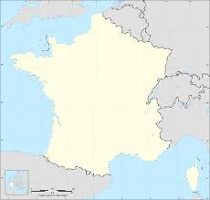
WELL-BEING
FRANCE
Happy at work
(% often)
Quality of life at work (% scores 8-10)
41%
#6*
#9
32%
CONFIDENCE
Country future
(% confidents)
Professional future
(% confident)
26%
#11
#9
52%
Data (eurostat 2014)
Growth rate of GDP: 1%
Active population: 28,8 M
Unemployment rate: 10,4%
*# rank among the 14 European countries
MOTIVATION
Motivation
(% is increasing + remaining stable)
Concerns (%)
63%
#11
job
wage
time
DEVELOPMENT
Stay in your company
(% yes)
Find a comparable job
(% easy)
57%
#8
#9
31%

Slide 8
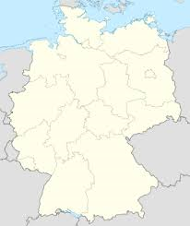
WELL-BEING
GERMANY
Happy at work
(% often)
Quality of life at work (% scores 8-10)
46%
#4*
#3
49%
CONFIDENCE
Country future
(% confidents)
Professional future
(% confident)
62%
#1
#1
67%
Data (eurostat)
Growth rate of GDP: 1,8%
Active population: 41,7 M
Unemployment rate: 5,1%
*# rank among the 14 European countries
MOTIVATION
Motivation
(% is increasing + remaining stable)
Concerns (%)
78%
#2
job
wage
time
DEVELOPMENT
Stay in your company
(% yes)
Find a comparable job
(% easy)
66%
#4
#4
41%

Slide 9
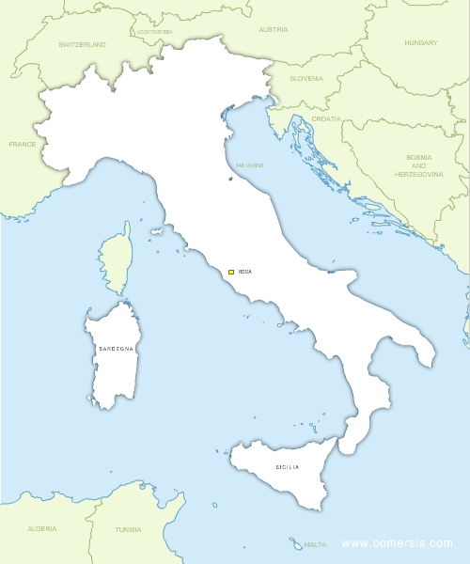
WELL-BEING
ITALY
Happy at work
(% often)
Quality of life at work (% scores 8-10)
34%
#8*
#12
26%
CONFIDENCE
Country future
(% confidents)
Professional future
(% confident)
23%
#12
#13
43%
Data (eurostat 2014)
Growth rate of GDP: 0,6%
Active population: 25,5 M
Unemployment rate: 12,8%
*# rank among the 14 European countries
MOTIVATION
Motivation
(% is increasing + remaining stable)
Concerns (%)
67%
#9
job
wage
time
DEVELOPMENT
Stay in your company
(% yes)
Find a comparable job
(% easy)
67%
#3
#11
21%

Slide 10
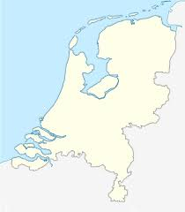
WELL-BEING
NETHERLANDS
Happy at work
(% often)
63%
41%
Quality of life at work (% scores 8-10)
#1*
#6
CONFIDENCE
Country future
(% confidents)
54%
64%
Professional future
(% confident)
#4
#3
Data (eurostat 2014)
Growth rate of GDP: 1,2%
Active population: 9 M
Unemployment rate: 7,4%
*# rank among the 14 European countries
MOTIVATION
Motivation
(% is increasing + remaining stable)
Concerns (%)
80%
#1
job
wage
time
DEVELOPMENT
Stay in your company
(% yes)
Find a comparable job
(% easy)
72%
#1
#6
38%

Slide 11
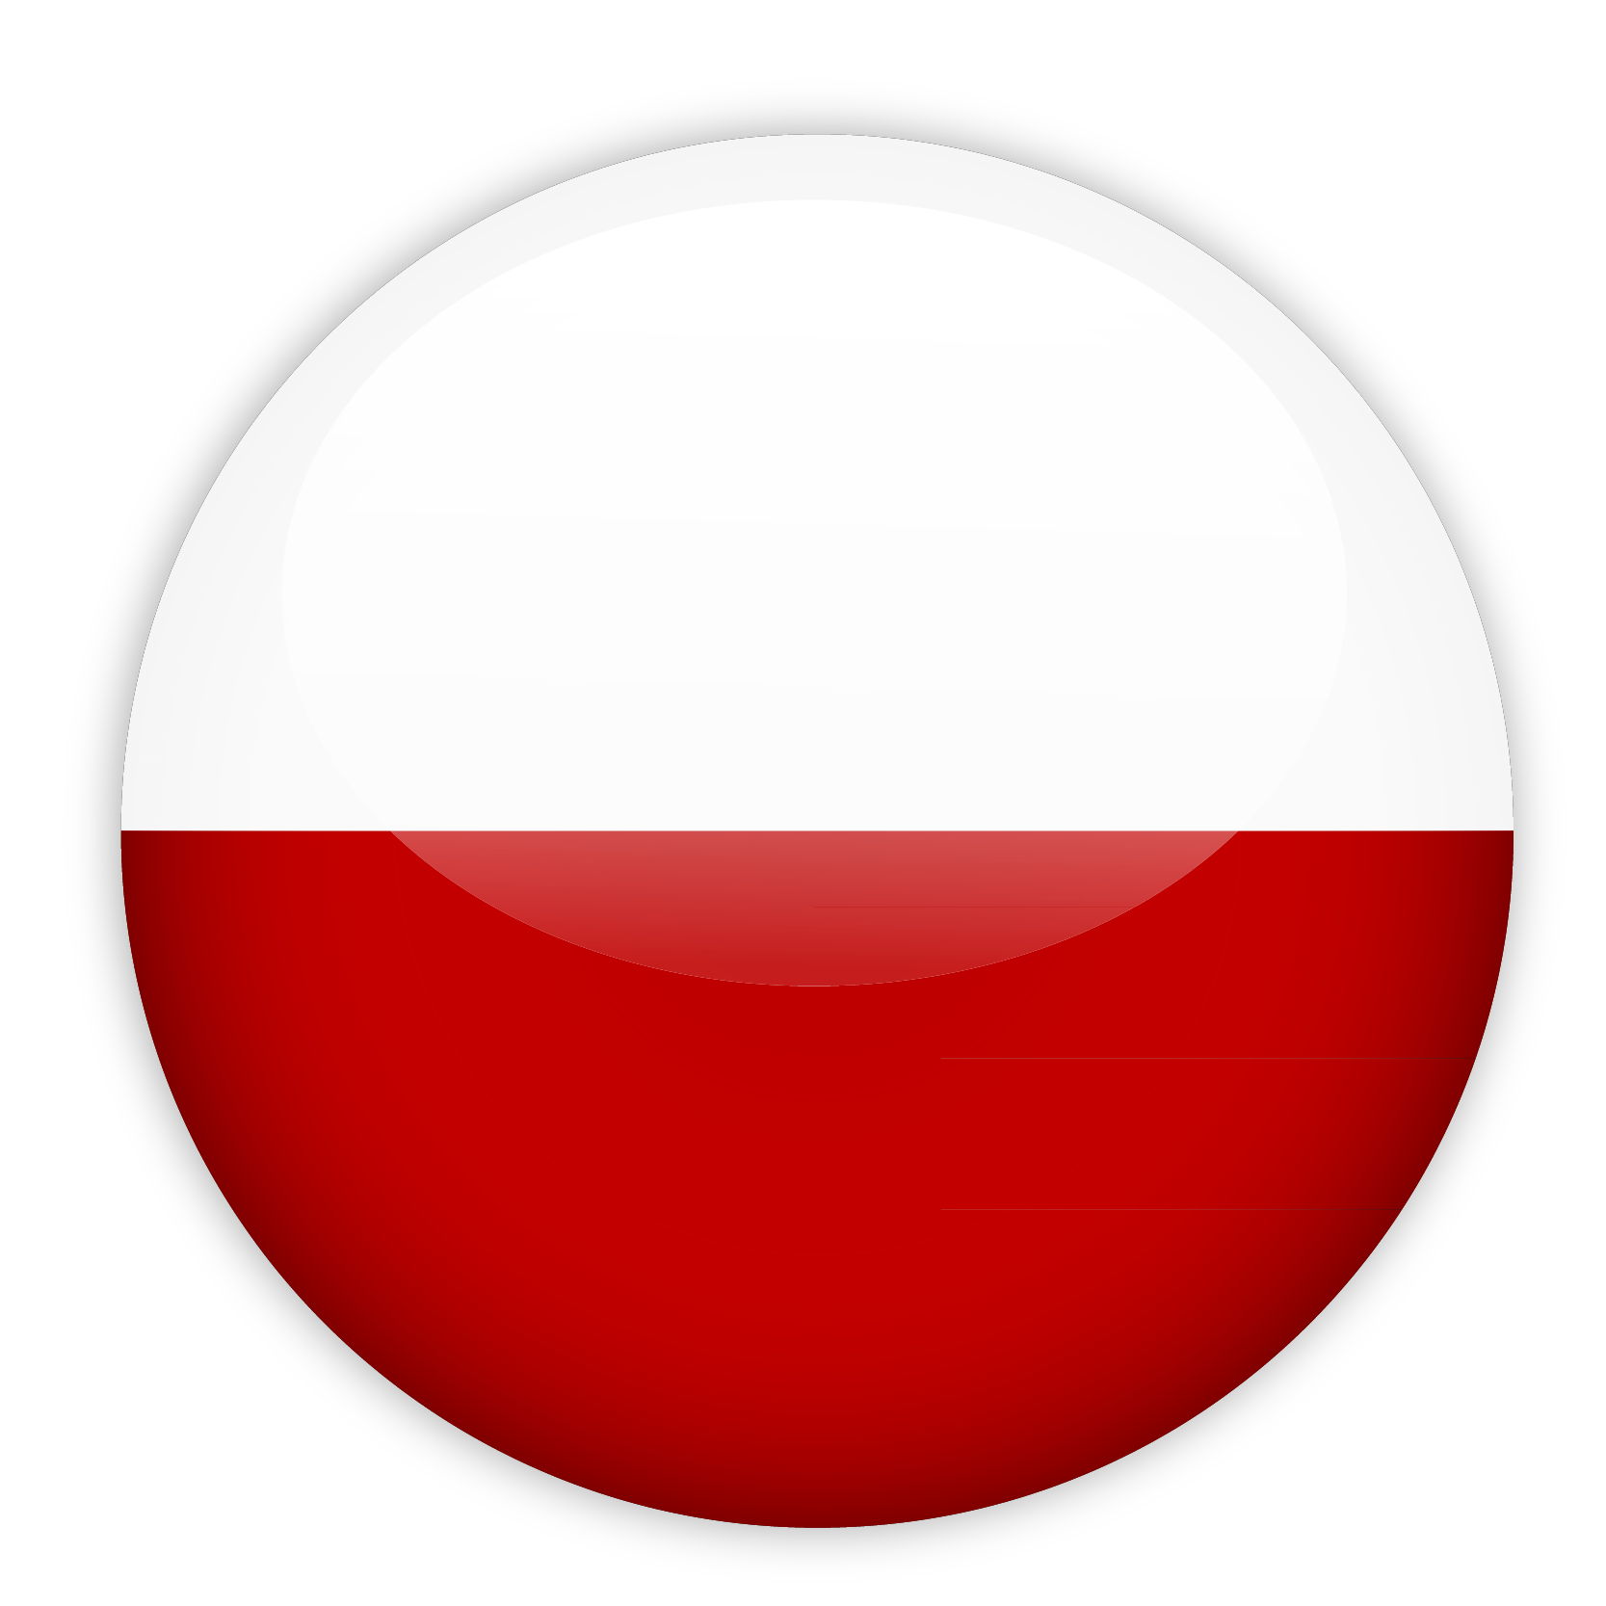
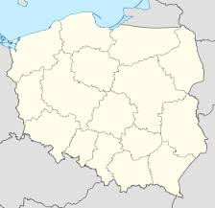
WELL-BEING
POLAND
Happy at work
(% often)
Quality of life at work (% scores 8-10)
22%
#12*
#11
27%
CONFIDENCE
CONFIANCE
Country future
(% confidents)
#10
Professional future
(% confident)
26%
#11
50%
Data (eurostat 2014)
Growth rate of GDP: 3,2%
Active population: 17,4
Unemployment rate: 9,9%
*# rank among the 14 European countries
MOTIVATION
MOTIVATION
Motivation
(% is increasing + remaining stable)
Concerns (%)
61%
#12
job
wage
time
DEVELOPPEMENT
DEVELOPMENT
Stay in your company
(% yes)
Find a comparable job
(% easy)
52%
#11
#2
46%

Slide 12
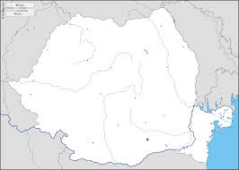
WELL-BEING
ROMANIA
Happy at work
(% often)
Quality of life at work (% scores 8-10)
31%
#10*
#8
39%
CONFIDENCE
Country future
(% confidents)
Professional future
(% confident)
34%
#8
#11
48%
Data (eurostat 2014)
Growth rate of GDP: 2,5%
Active population: 9,9 M
Unemployment rate: 7,2%
*# rank among the 14 European countries
MOTIVATION
Motivation
(% is increasing + remaining stable)
Concerns (%)
74%
#3
job
wage
time
DEVELOPMENT
Stay in your company
(% yes)
Find a comparable job
(% easy)
51%
#12
#3
43%

Slide 13
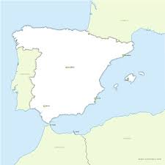
WELL-BEING
SPAIN
Happy at work
(% often)
Quality of life at work (% scores 8-10)
41%
#6*
#10
30%
CONFIDENCE
Country future
(% confidents)
29%
Professional future
(% confident)
#10
#7
57%
Data (eurostat 2014)
Growth rate of GDP: 1,1%
Active population: 23,2 M
Unemployment rate: 25,5%
*# rank among the 14 European countries
MOTIVATION
Motivation
(% is increasing + remaining stable)
Concerns (%)
70%
#7
job
wage
time
DEVELOPMENT
Stay in your company
(% yes)
Find a comparable job
(% easy)
60%
#6
#10
26%

Slide 14
WELL-BEING
SWEDEN
Happy at work
(% often)
Quality of life at work (% scores 8-10)
44%
#5*
#4
46%
CONFIDENCE
Country future
(% confidents)
Professional future
(% confident)
55%
#3
#6
60%
Data (eurostat 2014)
Growth rate of GDP: 2,8%
Active population: 5,1 M
Unemployment rate: 7,6%
*# rank among the 14 European countries
MOTIVATION
Motivation
(% is increasing + remaining stable)
Concerns (%)
70%
#7
job
wage
time
DEVELOPMENT
Stay in your company
(% yes)
Find a comparable job
(% easy)
70%
#2
#1
53%

Slide 15
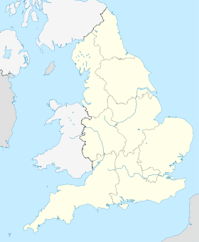
WELL-BEING
United Kingdom
Happy at work
(% often)
32%
43%
Quality of life at work (% scores 8-10)
#9*
#5
CONFIDENCE
Country future
(% confidents)
53%
61%
Professional future
(% confident)
#5
#5
Data (eurostat)
Growth rate of GDP: 2,7%
Active population: 32,4 M
Unemployment rate: 6,6%
*# rank among the 14 European countries
MOTIVATION
Motivation
(% is increasing + remaining stable)
Concerns (%)
69%
#8
job
wage
time
DEVELOPMENT
Stay in your company
(% yes)
Find a comparable job
(% easy)
56%
#9
#7
37%

Slide 16
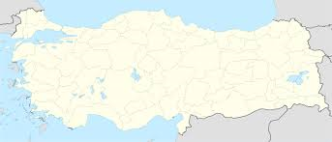
WELL-BEING
TURKEY
Happy at work
(% often)
Quality of life at work (% scores 8-10)
34%
#8*
#13
25%
CONFIDENCE
Country future
(% confidents)
Professional future
(% confident)
31%
#9
#12
46%
Data (eurostat 2014)
Growth rate of GDP: 3%
Active population: 28 M
Unemployment rate: 9,5%
*# rank among the 14 European countries
MOTIVATION
Motivation
(% is increasing + remaining stable)
Concerns (%)
64%
#10
job
wage
time
DEVELOPMENT
Stay in your company
(% yes)
Find a comparable job
(% easy)
53%
#10
#2
46%

